Slide 1
Homework part1
Notes:
可以使用以下網站來舉例
https://escher.github.io/#/app?map=e_coli_core.Core%20metabolism&tool=Builder&model=e_coli_core

Slide 2
FORt2: for_e + h_e --> for_c + h_c
Formate + H+ --> Formate + H+
h_e
h_c
FORt2
The same
The same
Unique metabolites: [“for” , “h”]
Number of Unique metabolites: 2
for_e
for_c
extracellular
cytosol
Hint: use cobra.reaction.metabolites
Notes:
作業一是要請大家把每一個Reactions的unique metabolite抓出來算數量
問題可能比較是unique metabolite是甚麼意思
在cobra中同一個名稱的metabolite在不同compartment中是不一樣的物件
但實際上是同一個化合物
這個例子是FORt2這個reaction
這個Reactions有四個metabolites: h_e, h_c, for_e, for_c
但h_e, h_c是同樣的，for_e, for_c也是同樣的
所以Number of Unique metabolites是 2
可以用上課提到的cobra.reaction.metabolites
去把每一個reactions裡面的metabolites抓出來
會return一個dict object, key是一個cobra.metabolite物件，value是stoichiometric coefficient
就可以再把metabolites的name抓出來，然後算不重複的數量有幾個
model的視覺化可以使用以下網站來舉例
https://escher.github.io/#/app?map=e_coli_core.Core%20metabolism&tool=Builder&model=e_coli_core

Slide 3
All reactions in the textbook model
NADH16
NADTRHD
NH4t
O2t
PDH
PFK
PFL
PGI
PGK
PGL
PGM
PIt2r
PPC
PPCK
PPS
PTAr
PYK
PYRt2
RPE
RPI
SUCCt2_2
SUCCt3
ACALD
ACALDt
ACKr
ACONTa
ACONTb
ACt2r
ADK1
AKGDH
AKGt2r
ALCD2x
ATPM
ATPS4r
Biomass_Ecoli_core
CO2t
CS
CYTBD
D_LACt2
ENO
ETOHt2r
EX_ac_e
EX_acald_e
EX_akg_e
EX_co2_e
EX_etoh_e
EX_for_e
EX_fru_e
EX_fum_e
EX_glc__D_e
EX_gln__L_e
EX_glu__L_e
EX_h_e
EX_h2o_e
EX_lac__D_e
EX_mal__L_e
EX_nh4_e
EX_o2_e
EX_pi_e
EX_pyr_e
EX_succ_e
FBA
FBP
FORt2
FORti
FRD7
FRUpts2
FUM
FUMt2_2
G6PDH2r
GAPD
GLCpts
GLNS
GLNabc
GLUDy
GLUN
GLUSy
GLUt2r
GND
H2Ot
ICDHyr
ICL
LDH_D
MALS
MALt2_2
MDH
ME1
ME2
SUCDi
SUCOAS
TALA
THD2
TKT1
TKT2
TPI
Notes:
這邊是textbook裡面每一個reactions
大家要去抓這些reactions並算unique metabolite的量

Slide 4
Number of unique metabolites
Reaction
… ...
… ...
TPI
NH4t
NADH16
NADTRHD
Notes:
這是我希望大家可以畫出來的圖的樣子
X軸是每一個Reactions 的 ID
Y軸是reactions對應的unique metabolite數量

Slide 5
Homework part2

Slide 6
R1
R4
M1
M2
R3
R2
R5
M3
M4
Reaction ID | R1 | R2 | R3 | R4 | R5
Related reactions | R3 | R3 | R1, R2, R4, R5 | R3 | R3
Shared metabolites | M1 | M3 | M1, M2, M3, M4 | M2 | M4
Notes:
第二題我希望大家可以抓出每一個reactions的related Reactions數量，並做histogram
Reaction的related Reaction是指share同一個metabolites
這個例子中 R1就跟R3 share M1
所以他們互相是彼此的related Reaction
下面這個表格就給大家參考一下
可以使用以下網站來舉例
https://escher.github.io/#/app?map=e_coli_core.Core%20metabolism&tool=Builder&model=e_coli_core

Slide 7
Number of Reactions
4
R5
R4
R2
1
R1
R3
Number of related
Reactions
0
1
2
3
4
Notes:
最後想請大家畫的是這張圖
X軸是有多少個related Reactions
Y軸是有這些related Reaction數量的Reaction總共有幾個
舉例來說
R1. R2. R4. R5的related reaction都只有1個
R3有4個
那histogram就會像是這樣

Slide 8
Homework part3

Slide 9
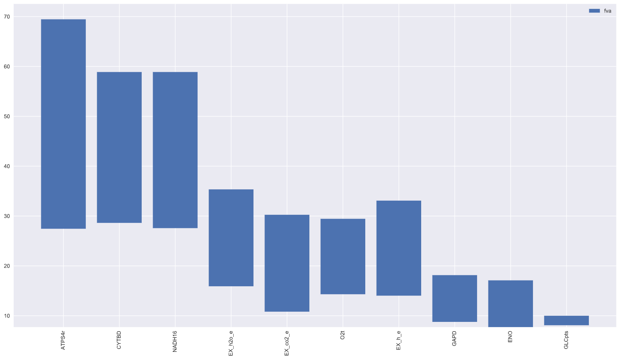
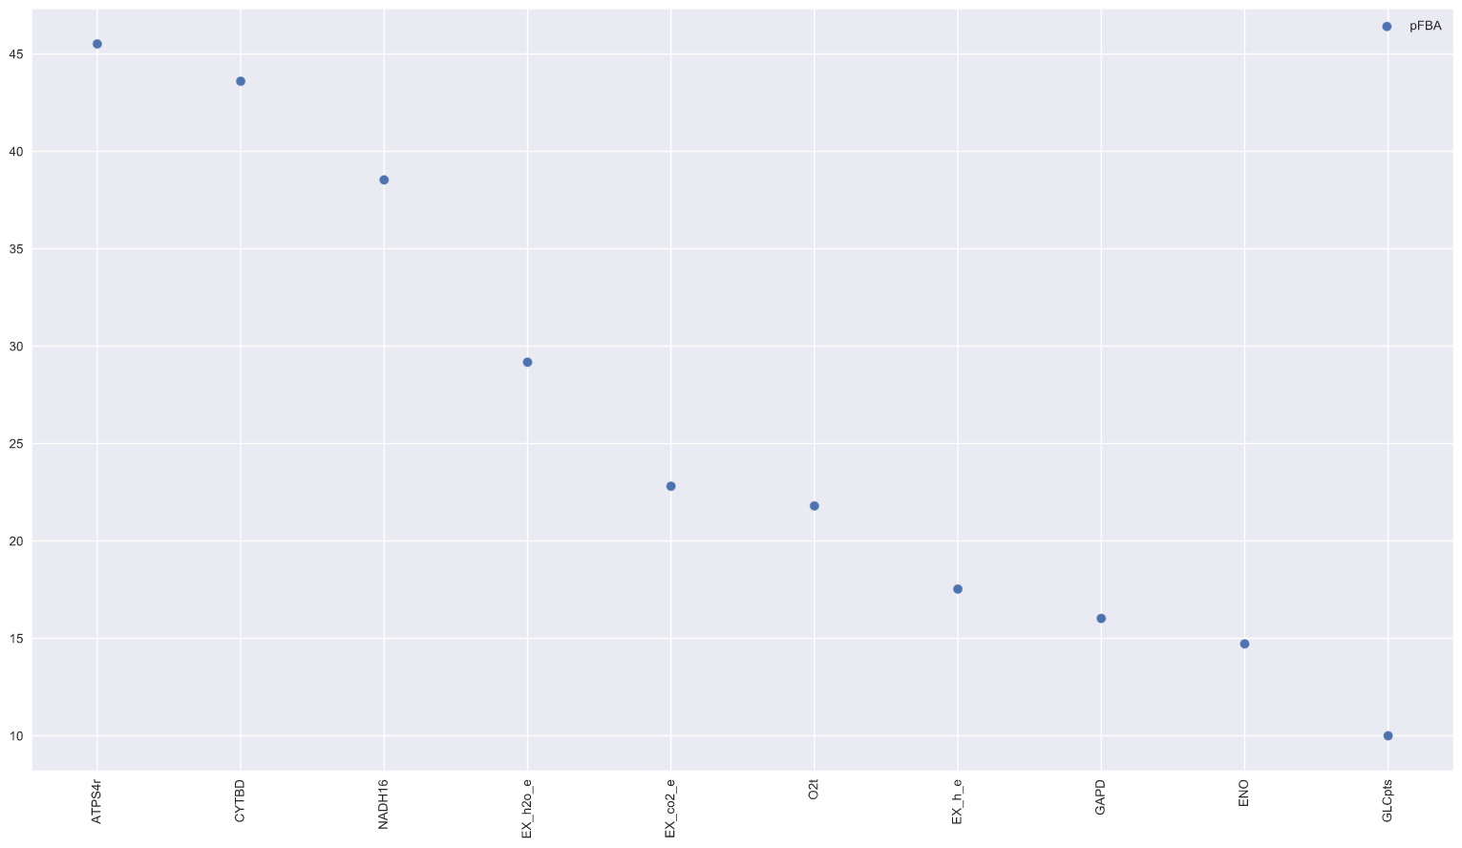
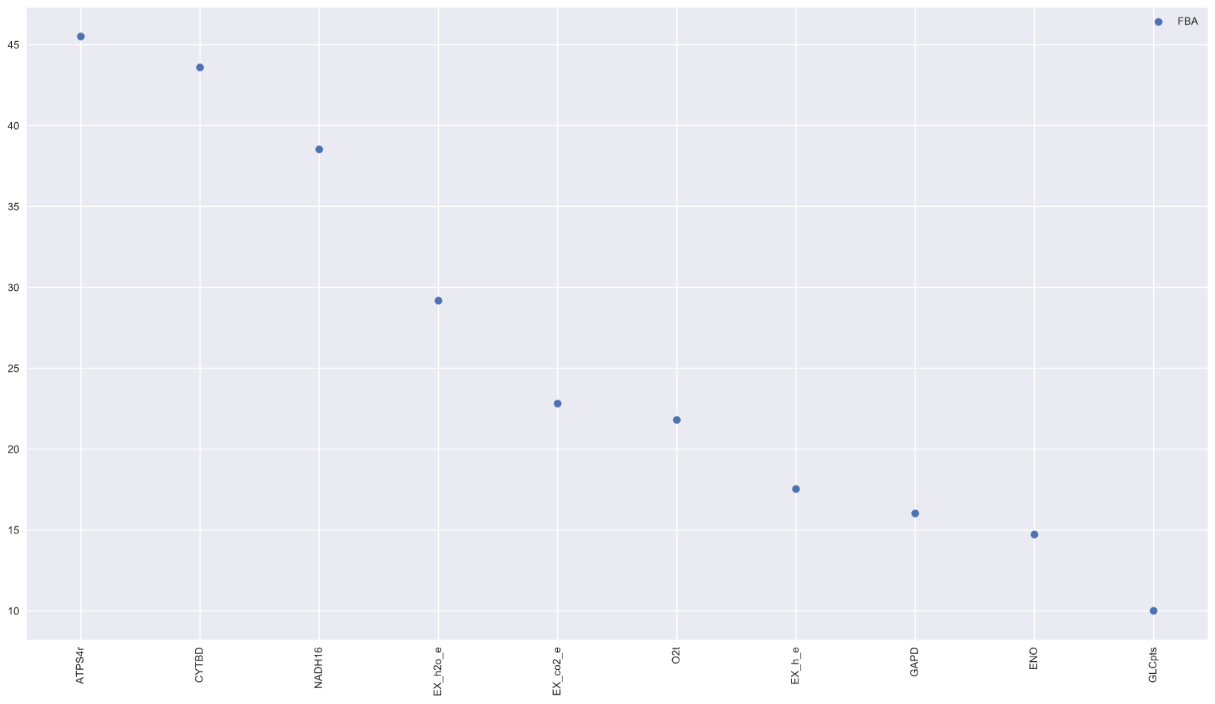
Notes:
FBA希望大家畫的圖是scatter plot
可以用matplotlib的plt.scatter()
這邊是textbook model的前10個reactions的FBA

Slide 10
Notes:
pFBA也一樣

Slide 11
plt.bar(X, RANGES, bottom=MINIMUM, label="fva")
Notes:
FVA希望大家畫的圖是bar plot
就是flux的maximum～minimum的range畫成一個長條
可以用matplotlib的plt.bar()
這邊的X是一個list或array，放The x coordinates of the bars.→ 例如: [0, 1, 2, 3, 4, … , 9]
RANGES放 flux range的list或array， →例如: [42.01, 30.26, 31.31, 19.43, 19.43, 15.13, 19.06, 9.37, 9.37, 1.91] (這是上面的例子)
bottom放minimum的值的list或array， → 例如: [27.44, 28.62, 27.57, 15.91, 10.81, 14.31, 14.02, 8.77, 7.72, 8.09] (這是上面的例子)
這邊是textbook model的前10個reactions的FVA結果

Slide 12
R1
M1
R2
M2
R3
Reactions
R1
R2
R3
Constraints
0 - 10
0 - 10
0 - 10
Feasible Flux
0 - 10
0 - 10
0 - 10
Optimized Flux
10
10
10

Slide 13
R1
M1
R2
M2
R3
Flux
10
Reaction
R1
R2
R3

Slide 14
FBA
R1
M1
R2
M2
R3
Flux
10
Reaction
R1
R2
R3

Slide 15
FVA
R1
M1
R2
M2
R3
Flux
10
FBA objective value
8
Reaction
R1
R2
R3

Slide 16
R2
R1
M1
M2
R3
M3
R4
R5
Flux
10
Flux that FBA may choose
Flux that pFBA will choose
Flux that both of FBA and pFBA will choose
Reaction
R1
R2
R3
R4
R5

Slide 17
sampling
R1
M1
R2
M2
R3
Flux
Probability
10
8
7
5
4
2
Reaction
Flux
R1
R2
R3
2.5
5.0
7.5
10

Slide 18
loopless
R2
R1
M1
M2
R3
M3
R4
R5
Flux
Flux
510
510
500
500
loopless
10
10
R1
R2
R3
R4
R5
R1
R2
R3
R4
R5

Slide 19
Comparison
Analysis | FBA | FVA | pFBA | Randomized sampling
Metabolic flux | A value | A range | A value | A value
Loopless | Optional | Optional | Yes | No
Relate to objective | Yes | Yes | Yes | No

Slide 20
Gene deletion
G2
G1
R2
G3
R1
M1
M2
R3
M3
R4
R5
G4
Status
G1
G2
G3
G4
infeasible
optimal
infeasible
optimal
essential
essential

Slide 21
Model extraction methods
G2
G1
R2
G3
R1
M1
M2
R3
M3
R4
R5
G4
G4
Omic data
Genes
G1
G2
G3
G4
Expression
High
High
High
Low

Slide 22
Extracted model
G2
G1
R2
G3
R1
M1
M2
R3

Slide 23
MEM | 演算法 | 種類 | Advantage | Disadvantage
iMAT-like | 將omic data轉換成reaction的weight 找出最大化weight的reactions set | iMAT INIT/tINIT | Do not need a RMF. | longer computing time required
GIMME-like | 計算Inconsistency score(IS) : sum((threshold – data_i) * flux_i) 2. 透過最小化IS來最小化low expression reactions的使用量，但同時維持 objective function(RMF)的值在某個定值以上 | GIMME GIM3E | the operability constraint may lead to more accurate context-specific model reconstructions and flux distributions. | the selection of RMF(required) is much more challenging for eukaryotic organisms.
MBA-like | 1. 首先須決定core reactions(不限決定方式，可以是透過omics data或literatures) 2. algorithm會找出需要維持core的最少量reactions作為extracted model的reactions | MBA mCADRE FastCORE | Possible to integrate multiple data sets of different nature together with well-curated biochemical knowledge. | Provide only a context-specific model reconstruction. time consuming(due to its manual nature).

Slide 24
1
Opdam, S., Richelle, A., Kellman, B., Li, S., Zielinski, D. C. and Lewis, N. E. (2017). A Systematic Evaluation of Methods for Tailoring Genome-Scale Metabolic Models. Cell systems 4(3), 318–329.e6.
2
Robaina Estévez, S. and Nikoloski, Z. (2014). Generalized framework for context-specific metabolic model extraction methods. Frontiers in plant science 5491.

